Slide 1

Software Design and architecture (SE322) gg
Week 07
Said Nabi
said.nabi@giki.edu.pk
Faculty of Computer Science and engineering
Gik Institute Topi, Swabi

Slide 2
List of Topics
Design patterns ( Creational, Structural, Behavioral)

Slide 3
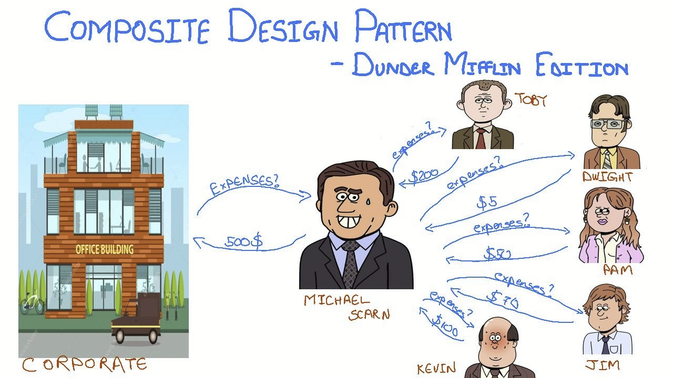
https://www.linkedin.com/pulse/composite-design-pattern-prateek-mishra

Slide 4
Composite Design Pattern
In a large organization, the corporate office needs to calculate total revenue generated by all branches, departments, and employees.
Without a structured approach, the corporate office must manually loop through each branch, then each department, and finally through every employee type like managers, sales staff, and receptionists.
For each type, the system has to check their role, apply different revenue or expense calculations, and then sum up the results.
This makes the code complex, repetitive, and hard to maintain — every time a new employee type or department is added, the code must be updated everywhere.

Slide 5
Composite Design Pattern Cont…
The Composite Design Pattern simplifies this problem by treating both individual employees and groups (departments or branches) uniformly.
It introduces a common interface (like calculateRevenue()) that is implemented by both individual employees and composite structures (departments or branches).
The Composite Design Pattern is used when you want to treat a group of objects and a single object in the same way.
It’s especially useful for representing hierarchical structures like trees — e.g., a company organization, file system, or UI components.

Slide 6
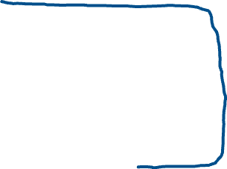


UML Diagram
<<interface>>
void calculateRevenue()
Click To See Java Code
Leaf Class
void calculateRevenue(){}
Composite Class
void calculateRevenue(){}

Slide 7
Composite Design Pattern Cont…
A Composite class holds and manages multiple components (which can be simple or complex), while a Leaf class represents a single, indivisible object.
Both implement the same Component interface, which allows us to treat single objects and whole groups uniformly.
A Composite object can include other Composite objects, forming a recursive or tree-like structure. This is called Recursive Composition, and it’s the core concept of the Composite Design Pattern, allowing us to build complex hierarchies (like company → branches → departments → employees) using a consistent and reusable structure.

Slide 8
Proxy Design Pattern
Sometimes in real life it’s easier, safer, or more convenient to use a representative instead of dealing with the real thing directly.
  a company might send a spokesperson to a conference instead of the CEO,
  crash test dummies are used instead of real people
In each of these examples, something is standing in place of something else — this is exactly what a Proxy does in software design.
The Proxy Design Pattern means that instead of directly communicating with a “real” object (which might be heavy, sensitive, or remote), you talk to a proxy — a middle class that represents or controls access to that real object.

Slide 9
Proxy Design Pattern Cont…
In software systems, we often face similar situations where directly accessing an object is not ideal because it might be heavy, sensitive, or remote.
A Proxy Design Pattern introduces a proxy class that represents the real subject class. The proxy acts as a lightweight version that can perform some tasks itself and delegate other tasks to the real object when necessary.
We use proxies when:
  Creating the real object consumes a lot of resources (like loading large images).
  We need to control or restrict who can access the real object (like checking user permissions).
  The real object is located remotely (like communicating with Google servers through a browser).
  In all these cases, the proxy ensures efficiency, security, and convenience.

Slide 10
Proxy Design Pattern Cont…
The proxy class wraps the real object. It hides a reference to the real subject and controls how and when it is accessed.
Both the proxy and the real subject implement the same interface so that the client can use them interchangeably.
The proxy can decide to handle simple requests itself or forward complex ones to the real object.
In the Proxy Pattern, there are three key components:
  Subject Interface: Defines common methods for both proxy and real subject.
  Real Subject: The actual object that performs the main work.
  Proxy: The representative that controls access and decides how to delegate tasks to the real subject.

Slide 11
Proxy Design Pattern Cont…
Imagine you run a global online retail store. When a customer places an order, you must decide which warehouse should fulfill it.
If you directly send all orders to warehouses without checking stock, some warehouses might receive orders they can’t fulfill.
The Proxy can act as a gatekeeper — it checks inventory first and only sends valid orders to warehouses that have the required stock.

Slide 12
UML Example
Client
Send Request
<<interface>>
IOrder
FulfilOrder(Order): void
Proxy Object
Real Object
OrderFulfilment
-Wharehouses: List<wharehouse>
+Fulfilorder(Order): void
Warehouse
-Stock: int -Address: String
+Fulfilorder(Order): void +CurrentInventory(item):int
Delegates to

Slide 13

Once upon a time, a developer created a basic web page.
It could display content using HTML, CSS, and a bit of JavaScript.
Everything was perfect — until one day, the client came with new requests:
“Can you make the page secure? Add authentication!”
“Also, only certain users should see special sections — add authorization!”
“And by the way, make it faster — add caching!”
The developer smiled. “Sure, I’ll just use inheritance like always.

Slide 14

A_S_Webpage
A_C_Webpage
S_C_Webpage
Webpage
A_S_C_Webpage
S_Webpage
A_Webpage
C_Webpage
Inheritance Explosion — Too Many Subclasses for Every Combination

Slide 15
Decorator Design Pattern
Instead of creating multiple subclasses for every possible combination of behaviors (like authentication, authorization, caching, or logging), the Decorator Design Pattern allows us to dynamically attach these behaviors to a single base object at runtime.
The pattern uses composition (has-a relationship) instead of inheritance to add new features, meaning we can wrap one object with another to incrementally add responsibilities without modifying existing code.
Each decorator adds its own functionality while keeping the original object unchanged, giving us the flexibility to mix and match features as needed rather than relying on a rigid class hierarchy.

Slide 16
Decorator Design Pattern Cont…
Because decorators share a common interface with the base component, they can be stacked together in any order, and the system still treats them uniformly — this makes behavior extension both modular and scalable.
The order of decoration can be changed at runtime to alter how features are applied, something that is impossible with traditional inheritance where behaviors are fixed at compile time.
This approach reduces code duplication, avoids subclass explosion, and keeps the system open for extension but closed for modification, adhering to one of the most important object-oriented design principles.

Slide 17
Decorator Design Pattern Cont…
The Decorator Design Pattern is a structural pattern that allows you to dynamically add new responsibilities or behaviors to objects at runtime by wrapping them inside special objects called decorators.
Each decorator implements the same interface as the object it decorates, ensuring that both can be used interchangeably.
It uses aggregation and delegation to extend functionality — each decorator object maintains a reference to another component object and calls its methods before or after adding its own behavior.
In simple terms, the decorator pattern lets you build flexible and layered combinations of behavior without altering existing classes, resulting in cleaner, more maintainable, and more adaptable software designs.

Slide 18


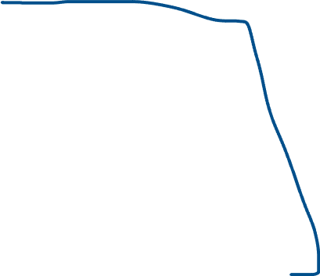


<<Webpage>>
+ display(): void
BasicWebpage
+ display(): void
WebpageDecorator
-page : Webpage
+display(): void
Authentication_Decorator
+display(): void
Authorization_Decorator
+display(): void

Slide 19
Thank You☺

